Slide 1
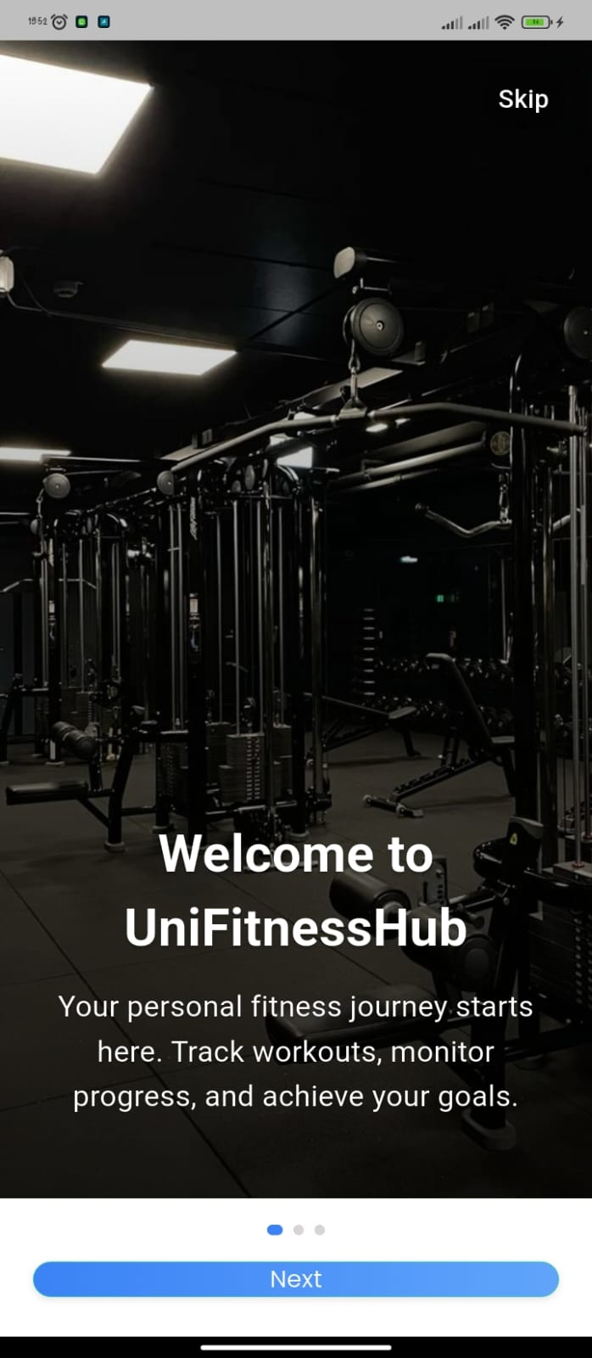
SMART FITNESS WORKOUT APP
FACULTY: FACULTY OF SCIENCE DEPARTMENT: COMPUTER SIENCE NAME: LAWRENCE KINUTHIA REG NO: EB1/61273/22
GYMAPP: Your all-in-one fitness companion for personalized workouts, nutrition, and progress tracking.

Slide 2
BACKGROUND TO THE STUDY
Physical fitness is vital for preventive healthcare
I found that existing apps lack personalization and interconnected tracking
Smart systems can provide adaptive, data-driven fitness support

Slide 3
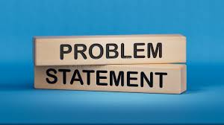
PROBLEM STATEMENT
A unified platform for managing both workouts and nutrition
Personalized recommendations based on their fitness goals
Easy-to-use interfaces for logging exercises and meals
Offline capability to track data without constant internet connectivity
Secure user authentication and data persistence

Slide 4
OBJECTIVES
General: Develop a personalized workout management and tracking app
Implement user authentication and profile management system
Develop workout management and exercise tracking functionality
Create an intelligent meal planning system based on user fitness goals and nutritional targets
Implement SQLite database for reliable local data persistence
Design responsive and intuitive user interfaces for all features
Integrate recommendation engine to provide personalized workout suggestions

Slide 5
SYSTEM DESIGN
UI Design: Clean, intuitive app for users and admins; easy navigation and tracking.
Database: Secure storage for users, workouts, nutrition, and progress.
Architecture: Layered design - Flutter app, service logic, repository/data access, SQLite scalable and modular.

Slide 6
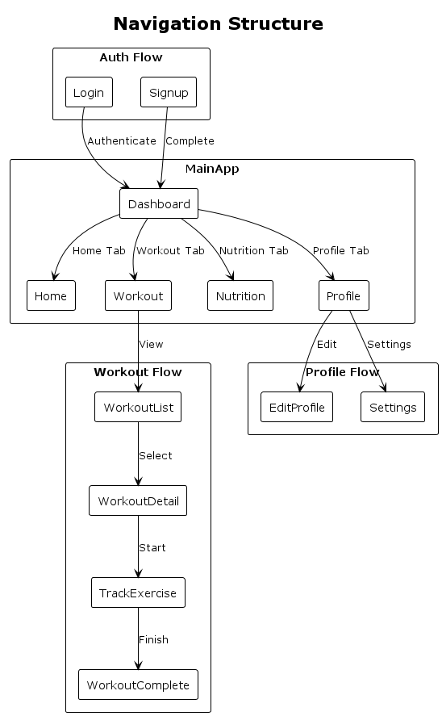

Slide 7

THANK YOU
&
Q&A
- Ready for questions
Notes:
Thank you for your attention! I are ready to answer any questions you may have about our project.

